Slide 1
National Acute Hospital Review
Emergency Department

Slide 2
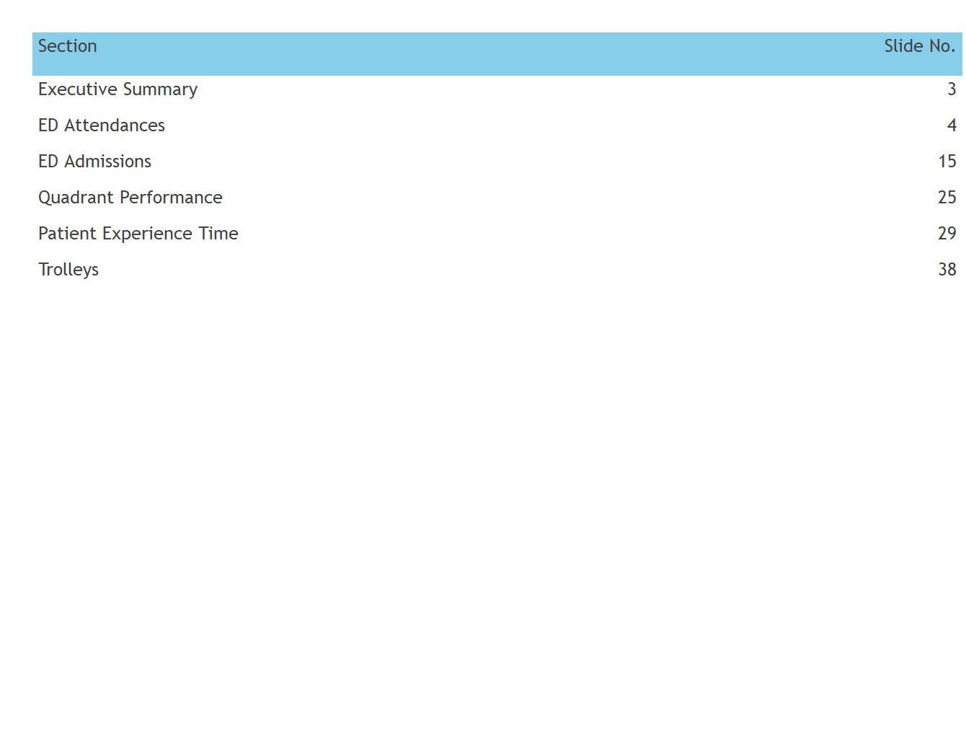
Contents

Slide 3
Executive Summary
KPI | Values | Comments
Monthly Attends | 78,242 | -32 % compared to March 2019
 |  | -15.5 % YTD
6 Hour PET | 70.6 % | Prior Month: 60.5 %
9 Hour PET | 85.1 % | Prior Month: 75.9 %
PET >= 24 hours | 1,408 | 98.2 % of all ED departures < 24 hours from registration.
8 AM Trolleys (YTD) | 2,611 | -72.9 % compared to March 2019
 | 23,839 (YTD) | -16.2 % compared to YTD 2019

Slide 4
ED Attendances

Slide 5
ED Attendances Trend (Bar)

Slide 6
ED Attendances Age Profile Trend

Slide 7
ED Attendances Age Profile Trend (% of Total)

Slide 8
ED Attendances Age Profile

Slide 9
ED Attendances Month & YTD
ED Attendances
 |  | 2020 |  |  | 2019 |  |  | Difference
Hospital Group | Hospital | March | YTD |  | March | YTD |  | March | YTD
Children's Health Ireland | Crumlin | 2,463 | 8,228 |  | 3,518 | 10,474 |  | -30% | -21.4%
 | Tallaght Paed | 1,475 | 6,259 |  | 3,124 | 9,155 |  | -52.8% | -31.6%
 | Temple Street | 2,647 | 9,799 |  | 4,708 | 14,437 |  | -43.8% | -32.1%
Dublin Midlands Hospitals Group | Naas | 1,802 | 6,468 |  | 2,590 | 7,630 |  | -30.4% | -15.2%
 | Portlaoise | 2,142 | 8,024 |  | 3,172 | 9,703 |  | -32.5% | -17.3%
 | St James's | 2,861 | 10,872 |  | 4,261 | 12,499 |  | -32.9% | -13%
 | Tallaght Adult | 3,196 | 11,548 |  | 4,487 | 13,043 |  | -28.8% | -11.5%
 | Tullamore | 2,073 | 7,449 |  | 2,920 | 8,589 |  | -29% | -13.3%
Ireland East Hospital Group | Mater | 5,116 | 18,912 |  | 7,204 | 20,682 |  | -29% | -8.6%
 | Mullingar | 2,117 | 7,662 |  | 3,231 | 9,523 |  | -34.5% | -19.5%
 | Navan | 1,218 | 4,645 |  | 1,812 | 5,158 |  | -32.8% | -9.9%
 | St Luke's Kilkenny | 2,543 | 9,598 |  | 3,802 | 11,255 |  | -33.1% | -14.7%
 | St Vincent's | 3,523 | 12,458 |  | 5,237 | 14,751 |  | -32.7% | -15.5%
 | Wexford | 2,564 | 9,088 |  | 3,554 | 10,473 |  | -27.9% | -13.2%
RCSI Hospitals Group | Beaumont | 3,528 | 12,468 |  | 5,034 | 14,393 |  | -29.9% | -13.4%
 | Cavan | 2,003 | 7,171 |  | 2,911 | 8,680 |  | -31.2% | -17.4%
 | Connolly | 2,802 | 9,763 |  | 3,570 | 10,458 |  | -21.5% | -6.6%
 | OLOL | 3,896 | 13,810 |  | 5,682 | 16,347 |  | -31.4% | -15.5%
Saolta Healthcare University Hospital Group | Galway | 3,879 | 13,865 |  | 5,791 | 16,854 |  | -33% | -17.7%
 | Letterkenny | 2,638 | 9,362 |  | 3,579 | 10,167 |  | -26.3% | -7.9%
 | Mayo | 2,270 | 8,139 |  | 3,380 | 9,518 |  | -32.8% | -14.5%
 | Portiuncula | 1,457 | 5,280 |  | 2,158 | 6,380 |  | -32.5% | -17.2%
 | Sligo | 2,532 | 8,976 |  | 3,616 | 10,238 |  | -30% | -12.3%
South/South West Hospital Group | CUH | 4,075 | 14,667 |  | 5,972 | 17,288 |  | -31.8% | -15.2%
 | Kerry | 2,007 | 7,373 |  | 3,079 | 8,751 |  | -34.8% | -15.7%
 | Mercy | 1,921 | 6,941 |  | 2,884 | 8,549 |  | -33.4% | -18.8%
 | South Tipp | 1,804 | 6,540 |  | 2,669 | 7,585 |  | -32.4% | -13.8%
 | Waterford | 3,215 | 12,219 |  | 4,943 | 14,245 |  | -35% | -14.2%
University of Limerick Hospital Group | Limerick | 4,475 | 15,512 |  | 6,255 | 18,143 |  | -28.5% | -14.5%
National |  | 78,242 | 283,096 |  | 115,143 | 334,968 |  | -32% | -15.5%

Slide 10
ED Attendances (Ages: 0-15) Month & YTD
ED Attendances (Ages:0-15)
 |  | 2020 |  |  | 2019 |  |  | Difference
Hospital Group | Hospital | March | YTD |  | March | YTD |  | March | YTD
Children's Health Ireland | Crumlin | 2,439 | 8,168 |  | 3,491 | 10,394 |  | -30.1% | -21.4%
 | Tallaght Paed | 1,471 | 6,245 |  | 3,117 | 9,141 |  | -52.8% | -31.7%
 | Temple Street | 2,623 | 9,750 |  | 4,689 | 14,388 |  | -44.1% | -32.2%
Dublin Midlands Hospitals Group | Naas | 1 | 14 |  | 9 | 31 |  | -88.9% | -54.8%
 | Portlaoise | 644 | 2,451 |  | 1,015 | 3,341 |  | -36.6% | -26.6%
 | St James's | 3 | 7 |  | 5 | 13 |  | -40% | -46.2%
 | Tallaght Adult | 0 | 1 |  | 0 | 3 |  |  | -66.7%
 | Tullamore | 248 | 888 |  | 449 | 1,113 |  | -44.8% | -20.2%
Ireland East Hospital Group | Mater | 0 | 0 |  | 0 | 1 |  |  | -100%
 | Mullingar | 538 | 2,114 |  | 986 | 3,009 |  | -45.4% | -29.7%
 | Navan | 4 | 35 |  | 18 | 55 |  | -77.8% | -36.4%
 | St Luke's Kilkenny | 550 | 2,183 |  | 1,022 | 3,109 |  | -46.2% | -29.8%
 | St Vincent's | 14 | 89 |  | 59 | 138 |  | -76.3% | -35.5%
 | Wexford | 591 | 2,010 |  | 905 | 2,665 |  | -34.7% | -24.6%
RCSI Hospitals Group | Beaumont | 1 | 10 |  | 4 | 17 |  | -75% | -41.2%
 | Cavan | 458 | 1,656 |  | 849 | 2,459 |  | -46.1% | -32.7%
 | Connolly | 2 | 14 |  | 6 | 20 |  | -66.7% | -30%
 | OLOL | 972 | 3,745 |  | 1,797 | 5,285 |  | -45.9% | -29.1%
Saolta Healthcare University Hospital Group | Galway | 731 | 2,777 |  | 1,306 | 3,841 |  | -44% | -27.7%
 | Letterkenny | 391 | 1,409 |  | 636 | 1,587 |  | -38.5% | -11.2%
 | Mayo | 459 | 1,614 |  | 809 | 2,312 |  | -43.3% | -30.2%
 | Portiuncula | 334 | 1,333 |  | 622 | 1,833 |  | -46.3% | -27.3%
 | Sligo | 439 | 1,607 |  | 663 | 1,897 |  | -33.8% | -15.3%
South/South West Hospital Group | CUH | 745 | 2,911 |  | 1,254 | 3,696 |  | -40.6% | -21.2%
 | Kerry | 344 | 1,317 |  | 614 | 1,695 |  | -44% | -22.3%
 | Mercy | 209 | 945 |  | 423 | 1,337 |  | -50.6% | -29.3%
 | South Tipp | 368 | 1,332 |  | 616 | 1,706 |  | -40.3% | -21.9%
 | Waterford | 555 | 2,104 |  | 962 | 2,665 |  | -42.3% | -21.1%
University of Limerick Hospital Group | Limerick | 832 | 3,261 |  | 1,531 | 4,490 |  | -45.7% | -27.4%
National |  | 15,966 | 59,990 |  | 27,857 | 82,241 |  | -42.7% | -27.1%

Slide 11
ED Attendances (Ages: 75+) Month & YTD
ED Attendances (Ages:75+)
 |  | 2020 |  |  | 2019 |  |  | Difference
Hospital Group | Hospital | March | YTD |  | March | YTD |  | March | YTD
Dublin Midlands Hospitals Group | Naas | 259 | 971 |  | 407 | 1,243 |  | -36.4% | -21.9%
 | Portlaoise | 198 | 848 |  | 277 | 864 |  | -28.5% | -1.9%
 | St James's | 400 | 1,570 |  | 593 | 1,686 |  | -32.5% | -6.9%
 | Tallaght Adult | 368 | 1,300 |  | 483 | 1,361 |  | -23.8% | -4.5%
 | Tullamore | 373 | 1,275 |  | 457 | 1,321 |  | -18.4% | -3.5%
Ireland East Hospital Group | Mater | 559 | 2,116 |  | 829 | 2,456 |  | -32.6% | -13.8%
 | Mullingar | 254 | 896 |  | 333 | 1,004 |  | -23.7% | -10.8%
 | Navan | 191 | 724 |  | 328 | 836 |  | -41.8% | -13.4%
 | St Luke's Kilkenny | 349 | 1,391 |  | 484 | 1,447 |  | -27.9% | -3.9%
 | St Vincent's | 684 | 2,369 |  | 892 | 2,664 |  | -23.3% | -11.1%
 | Wexford | 334 | 1,337 |  | 474 | 1,393 |  | -29.5% | -4%
RCSI Hospitals Group | Beaumont | 633 | 2,357 |  | 902 | 2,623 |  | -29.8% | -10.1%
 | Cavan | 323 | 1,130 |  | 381 | 1,268 |  | -15.2% | -10.9%
 | Connolly | 345 | 1,289 |  | 481 | 1,419 |  | -28.3% | -9.2%
 | OLOL | 430 | 1,659 |  | 595 | 1,670 |  | -27.7% | -0.7%
Saolta Healthcare University Hospital Group | Galway | 444 | 1,751 |  | 692 | 2,030 |  | -35.8% | -13.7%
 | Letterkenny | 434 | 1,545 |  | 584 | 1,707 |  | -25.7% | -9.5%
 | Mayo | 363 | 1,394 |  | 531 | 1,483 |  | -31.6% | -6%
 | Portiuncula | 246 | 820 |  | 334 | 1,011 |  | -26.3% | -18.9%
 | Sligo | 388 | 1,433 |  | 584 | 1,634 |  | -33.6% | -12.3%
South/South West Hospital Group | CUH | 562 | 2,056 |  | 872 | 2,494 |  | -35.6% | -17.6%
 | Kerry | 315 | 1,126 |  | 424 | 1,247 |  | -25.7% | -9.7%
 | Mercy | 220 | 810 |  | 344 | 1,089 |  | -36% | -25.6%
 | South Tipp | 264 | 957 |  | 363 | 1,048 |  | -27.3% | -8.7%
 | Waterford | 422 | 1,651 |  | 662 | 1,978 |  | -36.3% | -16.5%
University of Limerick Hospital Group | Limerick | 603 | 2,072 |  | 778 | 2,163 |  | -22.5% | -4.2%
National |  | 9,961 | 36,847 |  | 14,084 | 41,139 |  | -29.3% | -10.4%

Slide 12
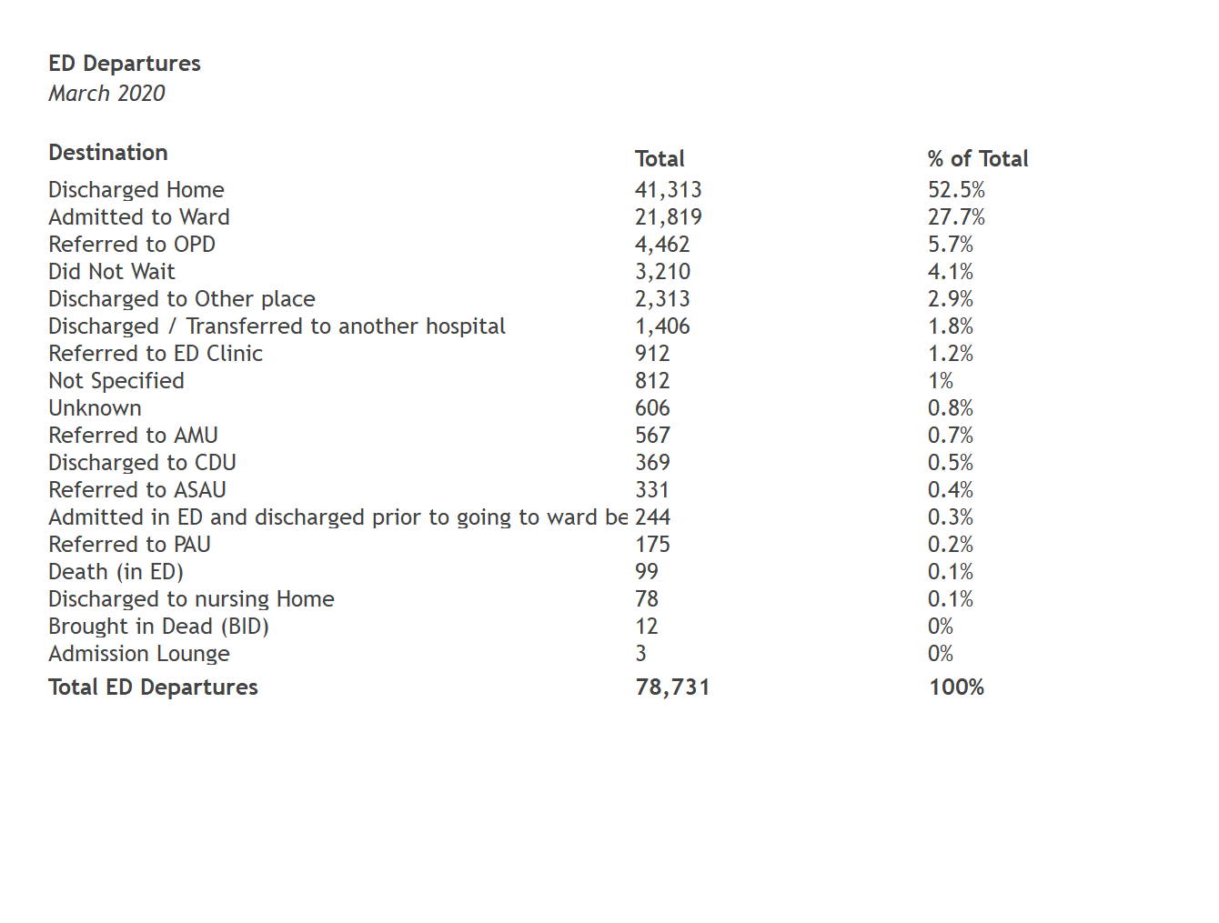
ED Departures By Destination

Slide 13
ED Admissions

Slide 14
ED Admissions Trend (Bar)

Slide 15
ED Admissions Age Profile

Slide 16
ED Admissions Month & YTD
ED Admissions
 |  | 2020 |  |  | 2019 |  |  | Difference
Hospital Group | Hospital | March | YTD |  | March | YTD |  | March | YTD
Children's Health Ireland | Crumlin | 330 | 1,131 |  | 445 | 1,283 |  | -25.8% | -11.8%
 | Tallaght Paed | 227 | 972 |  | 380 | 1,254 |  | -40.3% | -22.5%
 | Temple Street | 200 | 672 |  | 350 | 1,087 |  | -42.9% | -38.2%
Dublin Midlands Hospitals Group | Naas | 463 | 1,849 |  | 766 | 2,284 |  | -39.6% | -19%
 | Portlaoise | 463 | 1,907 |  | 819 | 2,588 |  | -43.5% | -26.3%
 | St James's | 916 | 3,179 |  | 1,182 | 3,553 |  | -22.5% | -10.5%
 | Tallaght Adult | 929 | 3,217 |  | 1,145 | 3,488 |  | -18.9% | -7.8%
 | Tullamore | 502 | 1,963 |  | 754 | 2,299 |  | -33.4% | -14.6%
Ireland East Hospital Group | Mater | 1,380 | 4,085 |  | 1,471 | 4,381 |  | -6.2% | -6.8%
 | Mullingar | 624 | 2,452 |  | 967 | 2,898 |  | -35.5% | -15.4%
 | Navan | 282 | 1,005 |  | 389 | 1,107 |  | -27.5% | -9.2%
 | St Luke's Kilkenny | 1,080 | 4,445 |  | 1,711 | 5,116 |  | -36.9% | -13.1%
 | St Vincent's | 1,515 | 4,398 |  | 1,504 | 4,352 |  | +0.7% | +1.1%
 | Wexford | 719 | 2,703 |  | 1,026 | 3,078 |  | -29.9% | -12.2%
RCSI Hospitals Group | Beaumont | 1,034 | 3,431 |  | 1,258 | 3,637 |  | -17.8% | -5.7%
 | Cavan | 600 | 2,099 |  | 838 | 2,454 |  | -28.4% | -14.5%
 | Connolly | 876 | 3,001 |  | 1,057 | 3,180 |  | -17.1% | -5.6%
 | OLOL | 1,169 | 4,191 |  | 1,597 | 4,802 |  | -26.8% | -12.7%
Saolta Healthcare University Hospital Group | Galway | 1,050 | 3,510 |  | 1,413 | 4,195 |  | -25.7% | -16.3%
 | Letterkenny | 1,073 | 3,485 |  | 1,283 | 3,722 |  | -16.4% | -6.4%
 | Mayo | 663 | 2,454 |  | 1,042 | 3,036 |  | -36.4% | -19.2%
 | Portiuncula | 444 | 1,675 |  | 636 | 1,953 |  | -30.2% | -14.2%
 | Sligo | 669 | 2,336 |  | 976 | 2,867 |  | -31.5% | -18.5%
South/South West Hospital Group | CUH | 1,332 | 4,382 |  | 1,699 | 5,149 |  | -21.6% | -14.9%
 | Kerry | 621 | 2,066 |  | 854 | 2,580 |  | -27.3% | -19.9%
 | Mercy | 542 | 1,746 |  | 547 | 1,650 |  | -0.9% | +5.8%
 | South Tipp | 695 | 2,585 |  | 963 | 2,772 |  | -27.8% | -6.7%
 | Waterford | 720 | 2,650 |  | 965 | 2,715 |  | -25.4% | -2.4%
University of Limerick Hospital Group | Limerick | 1,640 | 5,297 |  | 1,935 | 5,884 |  | -15.2% | -10%
National |  | 22,758 | 78,886 |  | 29,972 | 89,364 |  | -24.1% | -11.7%

Slide 17
ED Admissions (Ages: 0-15) Month & YTD
ED Admissions (Ages:0-15)
 |  | 2020 |  |  | 2019 |  |  | Difference
Hospital Group | Hospital | March | YTD |  | March | YTD |  | March | YTD
Children's Health Ireland | Crumlin | 317 | 1,105 |  | 439 | 1,256 |  | -27.8% | -12%
 | Tallaght Paed | 225 | 966 |  | 379 | 1,251 |  | -40.6% | -22.8%
 | Temple Street | 198 | 666 |  | 349 | 1,082 |  | -43.3% | -38.4%
Dublin Midlands Hospitals Group | Naas | 0 | 0 |  | 0 | 0
 | Portlaoise | 101 | 383 |  | 183 | 624 |  | -44.8% | -38.6%
 | St James's | 0 | 0 |  | 0 | 1 |  |  | -100%
 | Tallaght Adult | 0 | 0 |  | 0 | 0
 | Tullamore | 19 | 83 |  | 50 | 110 |  | -62% | -24.5%
Ireland East Hospital Group | Mater | 0 | 0 |  | 0 | 0
 | Mullingar | 93 | 389 |  | 156 | 484 |  | -40.4% | -19.6%
 | Navan | 0 | 0 |  | 0 | 0
 | St Luke's Kilkenny | 93 | 468 |  | 210 | 600 |  | -55.7% | -22%
 | St Vincent's | 2 | 9 |  | 2 | 14 |  | +0% | -35.7%
 | Wexford | 93 | 347 |  | 129 | 402 |  | -27.9% | -13.7%
RCSI Hospitals Group | Beaumont | 0 | 0 |  | 0 | 3 |  |  | -100%
 | Cavan | 85 | 289 |  | 132 | 364 |  | -35.6% | -20.6%
 | Connolly | 0 | 0 |  | 0 | 0
 | OLOL | 143 | 576 |  | 276 | 810 |  | -48.2% | -28.9%
Saolta Healthcare University Hospital Group | Galway | 129 | 503 |  | 236 | 637 |  | -45.3% | -21%
 | Letterkenny | 107 | 357 |  | 149 | 424 |  | -28.2% | -15.8%
 | Mayo | 65 | 218 |  | 94 | 313 |  | -30.9% | -30.4%
 | Portiuncula | 106 | 382 |  | 118 | 405 |  | -10.2% | -5.7%
 | Sligo | 64 | 246 |  | 143 | 418 |  | -55.2% | -41.1%
South/South West Hospital Group | CUH | 185 | 685 |  | 274 | 817 |  | -32.5% | -16.2%
 | Kerry | 110 | 390 |  | 228 | 713 |  | -51.8% | -45.3%
 | Mercy | 57 | 223 |  | 73 | 208 |  | -21.9% | +7.2%
 | South Tipp | 86 | 311 |  | 120 | 360 |  | -28.3% | -13.6%
 | Waterford | 43 | 158 |  | 53 | 161 |  | -18.9% | -1.9%
University of Limerick Hospital Group | Limerick | 251 | 949 |  | 394 | 1,039 |  | -36.3% | -8.7%
National |  | 2,572 | 9,703 |  | 4,187 | 12,496 |  | -38.6% | -22.4%

Slide 18
ED Admissions (Ages: 75+) Month & YTD
ED Admissions (Ages:75+)
 |  | 2020 |  |  | 2019 |  |  | Difference
Hospital Group | Hospital | March | YTD |  | March | YTD |  | March | YTD
Dublin Midlands Hospitals Group | Naas | 133 | 489 |  | 204 | 632 |  | -34.8% | -22.6%
 | Portlaoise | 93 | 440 |  | 164 | 503 |  | -43.3% | -12.5%
 | St James's | 251 | 923 |  | 342 | 965 |  | -26.6% | -4.4%
 | Tallaght Adult | 211 | 785 |  | 255 | 755 |  | -17.3% | +4%
 | Tullamore | 205 | 722 |  | 247 | 724 |  | -17% | -0.3%
Ireland East Hospital Group | Mater | 292 | 961 |  | 422 | 1,213 |  | -30.8% | -20.8%
 | Mullingar | 161 | 586 |  | 201 | 632 |  | -19.9% | -7.3%
 | Navan | 96 | 331 |  | 130 | 357 |  | -26.2% | -7.3%
 | St Luke's Kilkenny | 255 | 1,042 |  | 376 | 1,125 |  | -32.2% | -7.4%
 | St Vincent's | 440 | 1,368 |  | 483 | 1,447 |  | -8.9% | -5.5%
 | Wexford | 190 | 772 |  | 275 | 854 |  | -30.9% | -9.6%
RCSI Hospitals Group | Beaumont | 322 | 1,152 |  | 450 | 1,285 |  | -28.4% | -10.4%
 | Cavan | 189 | 622 |  | 218 | 704 |  | -13.3% | -11.6%
 | Connolly | 201 | 779 |  | 293 | 873 |  | -31.4% | -10.8%
 | OLOL | 266 | 1,040 |  | 373 | 1,084 |  | -28.7% | -4.1%
Saolta Healthcare University Hospital Group | Galway | 256 | 908 |  | 341 | 1,022 |  | -24.9% | -11.2%
 | Letterkenny | 284 | 987 |  | 371 | 1,108 |  | -23.5% | -10.9%
 | Mayo | 199 | 822 |  | 342 | 940 |  | -41.8% | -12.6%
 | Portiuncula | 121 | 456 |  | 200 | 572 |  | -39.5% | -20.3%
 | Sligo | 217 | 790 |  | 326 | 948 |  | -33.4% | -16.7%
South/South West Hospital Group | CUH | 333 | 1,029 |  | 422 | 1,294 |  | -21.1% | -20.5%
 | Kerry | 175 | 611 |  | 223 | 680 |  | -21.5% | -10.1%
 | Mercy | 140 | 508 |  | 171 | 570 |  | -18.1% | -10.9%
 | South Tipp | 179 | 651 |  | 259 | 730 |  | -30.9% | -10.8%
 | Waterford | 235 | 845 |  | 308 | 895 |  | -23.7% | -5.6%
University of Limerick Hospital Group | Limerick | 402 | 1,272 |  | 410 | 1,316 |  | -2% | -3.3%
National |  | 5,846 | 20,891 |  | 7,806 | 23,228 |  | -25.1% | -10.1%

Slide 19
Admission % by Hospital

Slide 20
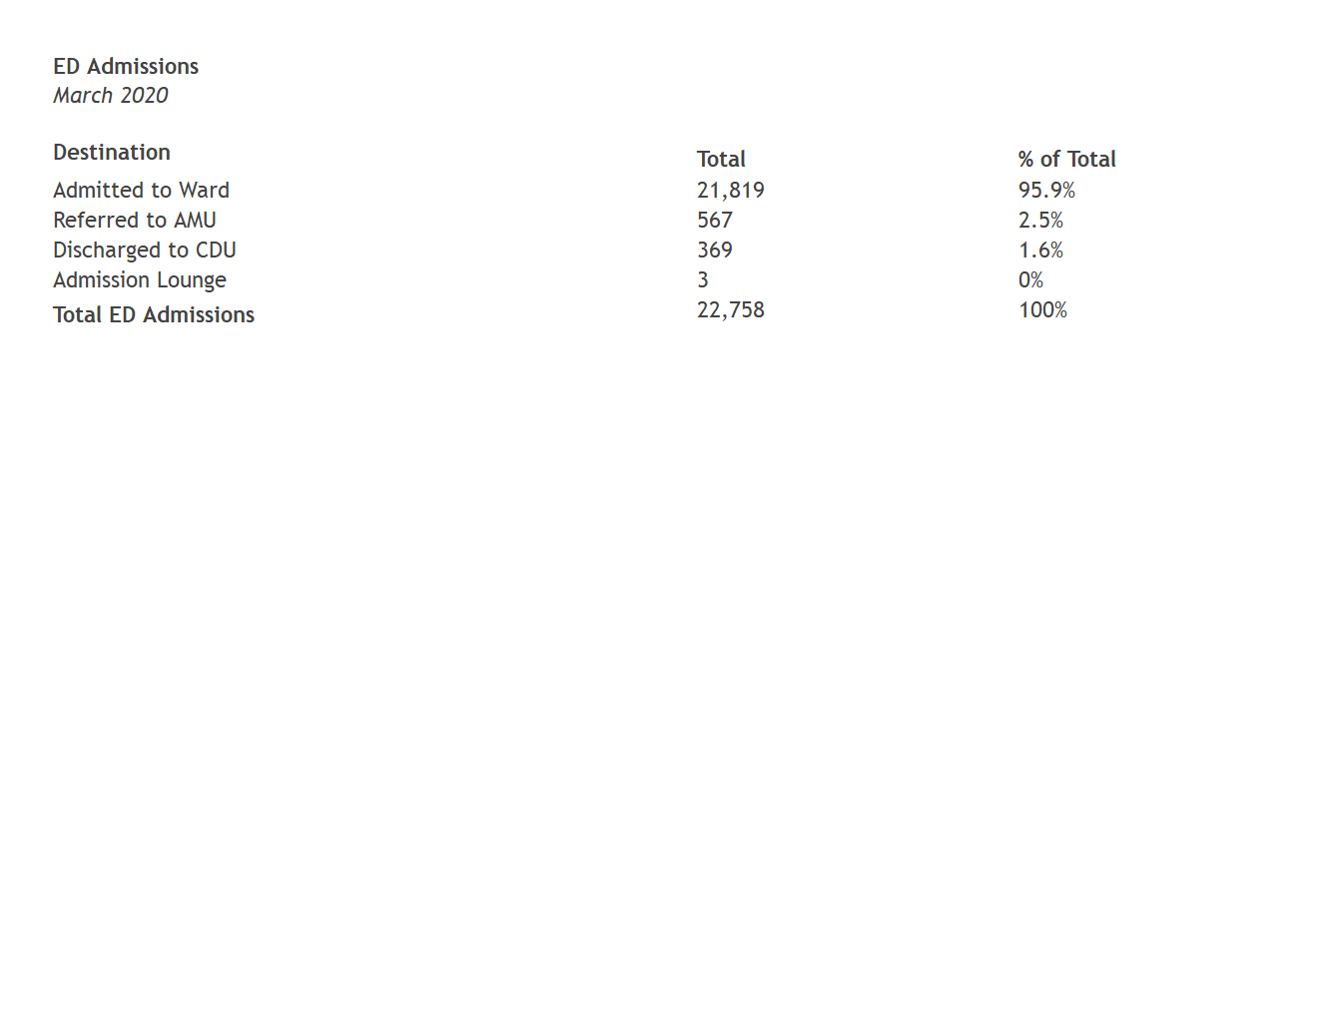
Admissions by Destination

Slide 21
Quadrant Performance

Slide 22
Note
ED records of patients with an age on registration less than 16 years are excluded from calculation of average PET and departure count.

Slide 23
Trolleys per 100 Departures Vs Mean PET

Slide 24
Trolleys per 100 Admissions Vs Mean Admitted PET

Slide 25
Patient Experience Time

Slide 26
Median PET By Hospital

Slide 27
PET Performance

Slide 28
PET Distribution

Slide 29
PET 6 & 9 Hour Performance By Hospital

Slide 30
PET 6 & 9 Hour Performance By Hospital (Admitted)

Slide 31
PET 6 & 9 Hour Performance By Hospital (Not-Admitted)

Slide 32
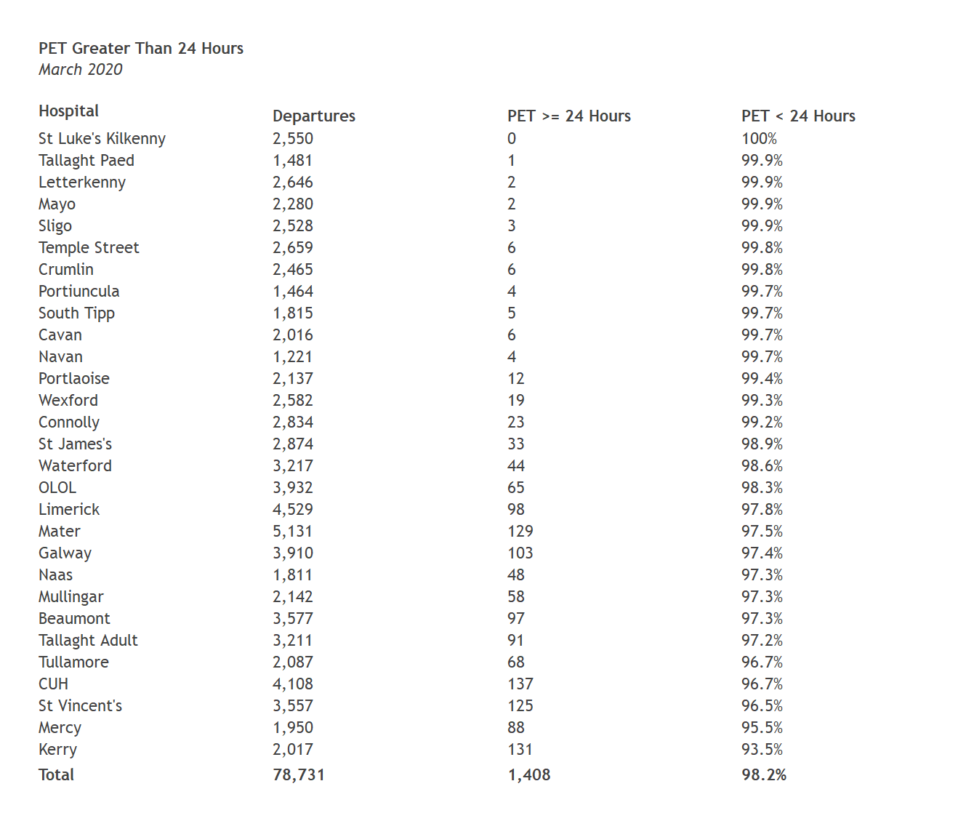
PET >= 24 Hours

Slide 33
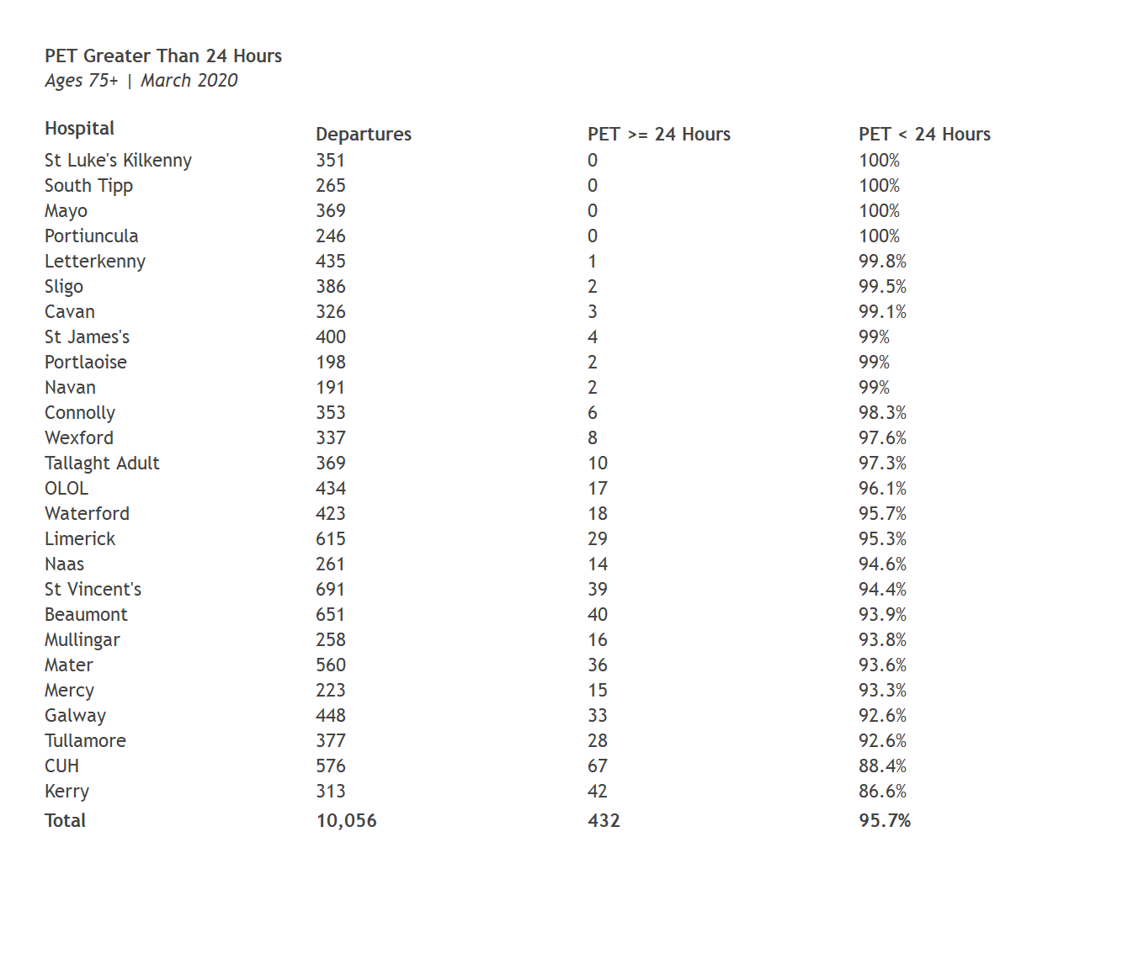
PET >= 24 Hours (Ages 75+)

Slide 34
Trolleys

Slide 35
Trolleys Month & YTD
8am TrolleyGAR
 |  | 2020 |  |  | 2019 |  |  | Difference
Hospital Group | Hospital | March | YTD |  | March | YTD |  | March | YTD
Dublin Midlands Hospitals Group | Naas | 34 | 526 |  | 494 | 1,214 |  | -93.1% | -56.7%
 | Portlaoise | 39 | 323 |  | 294 | 1,000 |  | -86.7% | -67.7%
 | St James's | 102 | 881 |  | 323 | 872 |  | -68.4% | +1%
 | Tallaght Adult | 96 | 842 |  | 325 | 1,042 |  | -70.5% | -19.2%
 | Tullamore | 107 | 789 |  | 426 | 1,326 |  | -74.9% | -40.5%
Ireland East Hospital Group | Mater | 152 | 1,604 |  | 614 | 1,745 |  | -75.2% | -8.1%
 | Mullingar | 174 | 913 |  | 242 | 662 |  | -28.1% | +37.9%
 | Navan | 12 | 226 |  | 69 | 204 |  | -82.6% | +10.8%
 | St Luke's Kilkenny | 74 | 551 |  | 178 | 453 |  | -58.4% | +21.6%
 | St Vincent's | 208 | 1,451 |  | 290 | 1,367 |  | -28.3% | +6.1%
 | Wexford | 61 | 498 |  | 295 | 798 |  | -79.3% | -37.6%
RCSI Hospitals Group | Beaumont | 39 | 515 |  | 257 | 835 |  | -84.8% | -38.3%
 | Cavan | 29 | 401 |  | 54 | 198 |  | -46.3% | +102.5%
 | Connolly | 15 | 388 |  | 197 | 576 |  | -92.4% | -32.6%
 | OLOL | 40 | 611 |  | 254 | 726 |  | -84.3% | -15.8%
Saolta Healthcare University Hospital Group | Galway | 181 | 2,201 |  | 937 | 2,266 |  | -80.7% | -2.9%
 | Letterkenny | 81 | 609 |  | 195 | 958 |  | -58.5% | -36.4%
 | Mayo | 29 | 919 |  | 301 | 942 |  | -90.4% | -2.4%
 | Portiuncula | 31 | 379 |  | 298 | 590 |  | -89.6% | -35.8%
 | Sligo | 89 | 551 |  | 398 | 1,216 |  | -77.6% | -54.7%
South/South West Hospital Group | CUH | 256 | 2,204 |  | 711 | 2,049 |  | -64% | +7.6%
 | Kerry | 209 | 1,337 |  | 499 | 1,391 |  | -58.1% | -3.9%
 | Mercy | 144 | 1,155 |  | 260 | 965 |  | -44.6% | +19.7%
 | South Tipp | 109 | 1,389 |  | 417 | 1,169 |  | -73.9% | +18.8%
 | Waterford | 133 | 1,118 |  | 566 | 1,903 |  | -76.5% | -41.3%
University of Limerick Hospital Group | Limerick | 167 | 1,458 |  | 751 | 1,987 |  | -77.8% | -26.6%
National |  | 2,611 | 23,839 |  | 9,645 | 28,454 |  | -72.9% | -16.2%

Slide 36
30-Day Moving Average (Year on Year Comparison)

Slide 37
30-Day Moving Average

Slide 38
Monthly Trolley Count by Hospital

Slide 39
% Contribution to Trolley Count

Slide 40
Change in YTD Trolley Count

Slide 41
% Change in YTD Trolley Count

